Slide 1
CENTRAL NERVOUS SYSTEM
EXAMINATION
Submitted by :-
Shubham Jain
BAMS 3rd year
Submitted to :-
Dr KK Chopra
Dr Shalini Tewari
Dr Ashvini Rana

Slide 2
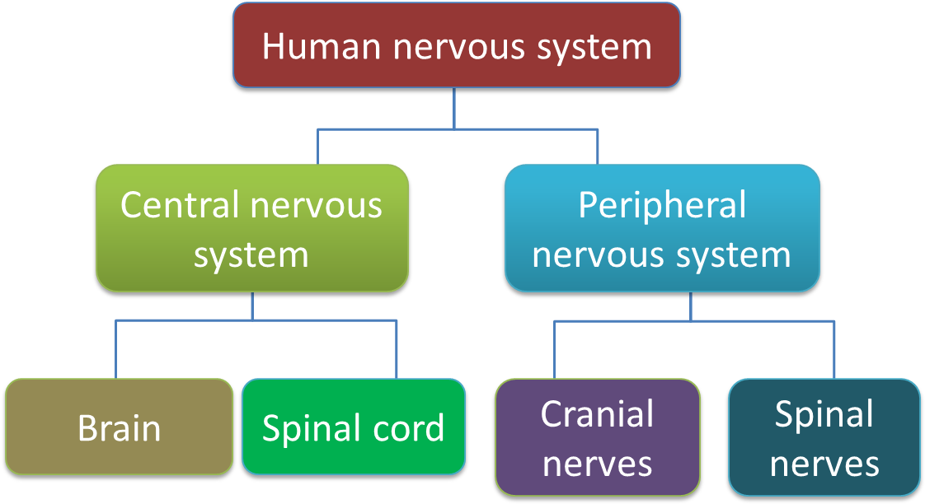
INTRODUCTION TO CNS

Slide 3
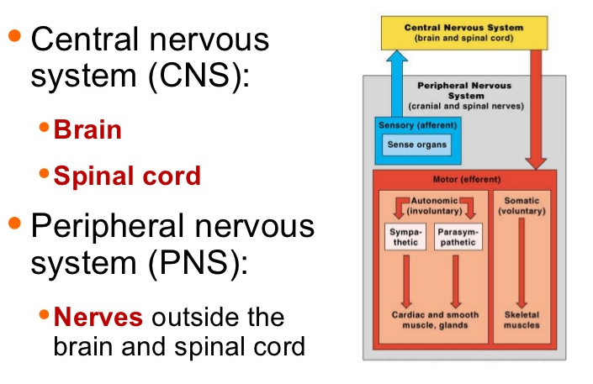
CLASSIFICATION OF NERVOUS SYSTEM

Slide 4
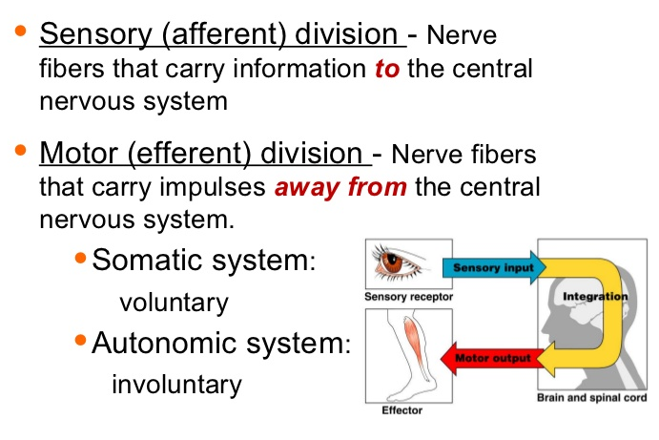
PERIPHERAL NERVOUS SYSTEM

Slide 5
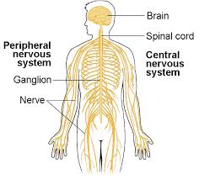
CNS AND PNS OVERVIEW

Slide 6
HISTORY
Presenting complaints
Onset : Sudden, Subacute, Insidous
Fever: Preceeding or concurrent and its severity
Evolution
Is there any symptoms of raised ICT ?
Seizure and their morphology

Slide 7
HISTORY
Any involvement of special senses & sphincters ?
Mental status
Family History
Etiologic History

Slide 8
GENERAL PHYSICAL EXAMINNATION
Look for 5S and FS
Look for MACEWEN’s SIGN
Look for operative scars on spine
Face should be examined
Skin should be screened
Teeth should be examined
Eyes should be examined
Vital signs should be recorded

Slide 9
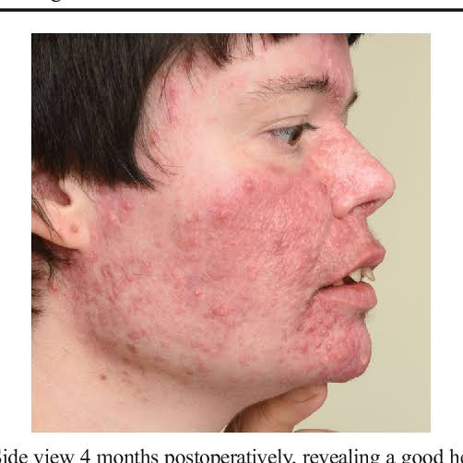
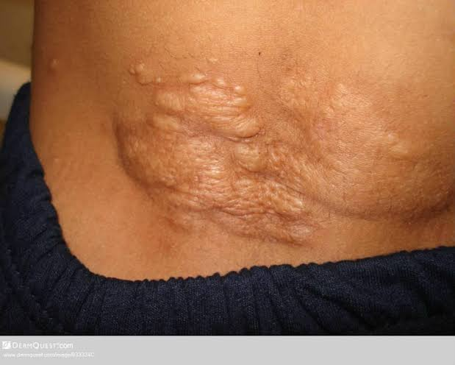
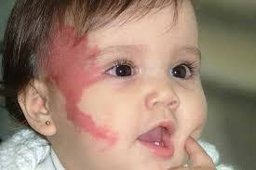
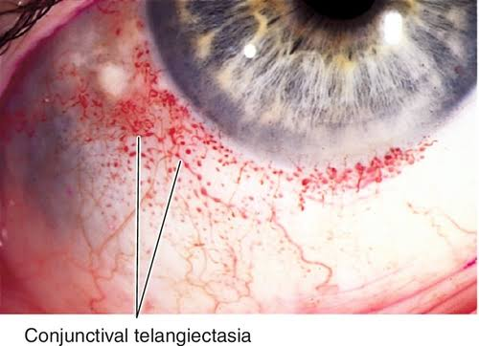
Adenoma sebacium
Shagreen spots
Strawberry mark

Slide 10
GENERAL PHYSICAL EXAMINATION
Look for TROUSSEAU’s SIGN and CHEVOSTEK’s SIGN
Look for the PERONEAL SIGN
Look for CUSHING’s RESPONSE
Look for Anaemia, Cyanosis, Jaundice
Spine should be examined
Handedness of the child

Slide 11
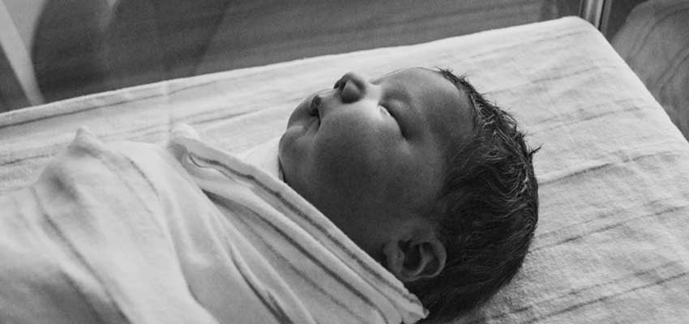
EXAMINATION OF CNS
Fun for both examiner and patient
Play attitude
Smile at infant
Soft speaking
Come down to level of child
Speak in reassuring tones
Attempt to localise all neurological abnormalities

Slide 12
ESSENTIAL TOOLS
Coloured toys/cubes
Reflex hammer
Bell
Flash light with rubber adapter
Fibreglass tape measure
Tuning fork
Objects for testing stereognosis
Two point discriminator
Development kit
Opthalmoscope

Slide 13
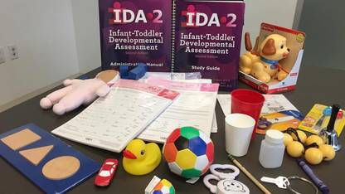
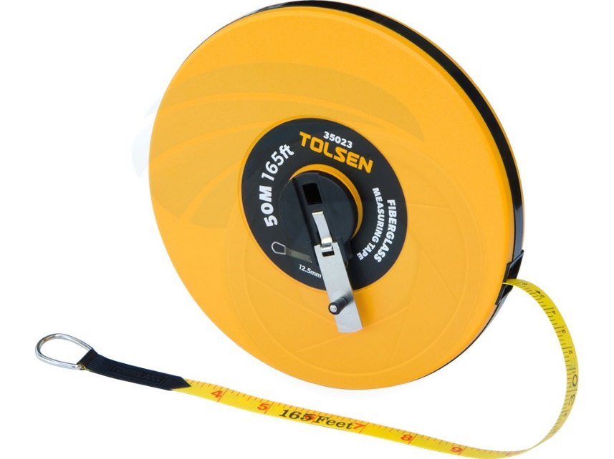
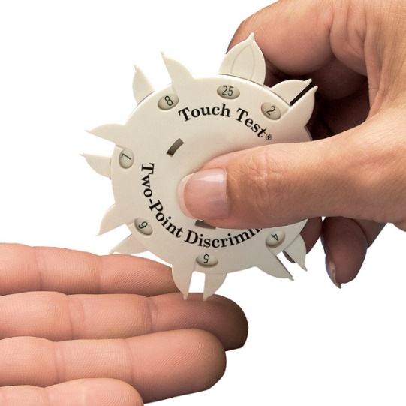
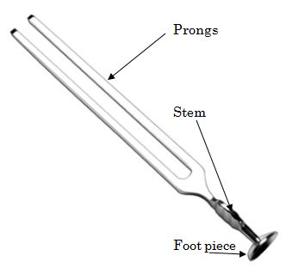
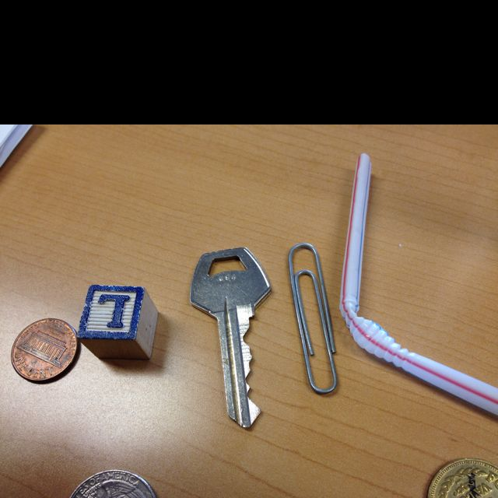


Slide 14
HIGHER MENTAL FUNCTIONS
LEVEL OF CONSIOUSNESS
EMOTIONAL STATUS
MEMORY & ORIENTATION
DELUSION & HALLUCINATION
SPEECH
{ In all comatosed children, brain stem reflexes such as pupillary response to light, corneal reflex, occulocephalic & occulovestibular reflexes must be assessed }

Slide 15
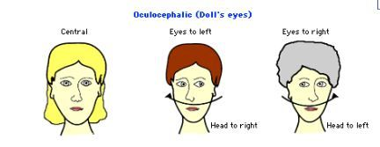
HIGHER MENTAL FUNCTIONS
Aphonia/Dysphonia
Sensory/Motor aphasis
Speech defects
6. Automatic neonatal reflex
7. Doll’s eye phenomenon

Slide 16
SIGNS OF MENINGEAL IRRITATION
LOOK FOR :-
Photophobia
Neck rigidity
Kernig’s sign
Brudzinski’s sign
Tripod’s sign

Slide 17
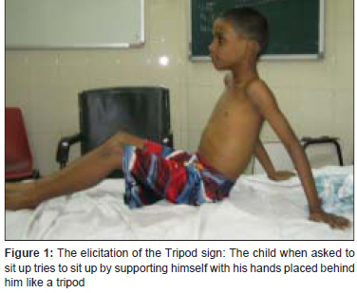
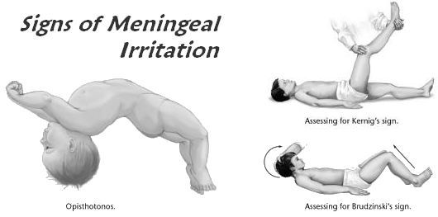
Kernig’s Brudzinki’s Tripod Sign

Slide 18
DEVELOPMENTAL SCREENING
CIRCLE - 3 yrs
TRIANGLE - 4yrs
SQUARE - 5yrs
Look for evidences of attention defecit Hyperactivity disorders in form of hyperkinetic behaviour, short attention spasm, easy distractability, motor clumsiness, soft neurological sign.

Slide 19
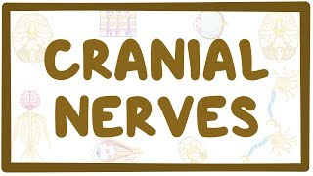

Slide 20
INTRODUCTION
Olfactory nerve
Optic nerve
Occulomotor nerve
Trochlear nerve
Trigeminal nerve
Abducent nerve
Facial nerve
Vestibulocochlear N
Glossopharyngeal N
Vagus nerve
Accessory nerve
Hypoglossal nerve

Slide 21
OLFACTORY NERVE
TESTING:-
Ask for any defect in smell
Identify some common odorous material
Avoid use of ammonia and acetic acid
Anosmia following Kallmann syndrome, hydrocephalus, hysteria
Parosmia

Slide 22
OPTIC NERVE
TESTING :-
Acuity of vision
Field of vision [ Confrontation test ]
Colour vision
Fundus examination

Slide 23
3rd 4th and 6th INTRODUCTION, External ocular muscles are supplied by these cranial nerves.
Muscles
Function
Medial rectus
Lateral rectus
Superior oblique
Inferior oblique
Superior rectus
Inferior rectus
Adduction
Abduction
Depression, abduction
Elevation, abduction
Elevation
Depression

Slide 24
TESTING
Diplopia
Look for squint, pupil, ptosis, nystagmus
Doll’s eye movement is used
Paralytic squint should be differentiated from concomitant squint

Slide 25
Occulomotor nerve testing
Diplopia
Bilateral ptosis
Pupil examination
Test of consensual reflex
Pin point pupils
Loss of accomodation
Argyll robertson pupils
Eye is displaced outwards and downwards

Slide 26
Trochlear nerve
Introduction
Nucleus lies in mid brain
Supplies superior oblique muscle
Slight upward and outward deviation of eye when nerve is paralyzed

Slide 27
Abducent nerve
Look for nystagmus.
What is Nystagmus ?

Slide 28
SYNDROMES involving 3rd 4th 6th CRANIAL NERVES
Horner syndrome
Perinaud’s syndrome
Gradenigo’s syndrome
Moebius syndrome
Benedikt’s syndrome
Weber’s syndrome
Pontine crossed paralysis
Milliard-Gubler syndrome
Foville’s syndrome

Slide 29
TRIGEMINAL NERVE
TESTING :-
Corneal or conjuctival reflex is lost
Sensory loss over scalp, cheek and mandible
Loss of pain, sensation on touch
Can’t clench his teeth
Deviation of Jaw

Slide 30
FACIAL NERVE
TESTING :-
Bell’s phenomenon
Ask to look upwards
Ask to cry
Ask to show teeth
Ask to whistle
Ask to blow cheeks
Examination of taste
Hyperacusis

Slide 31
VESTIBULO COCHLEAR NERVE
TESTING :-
Enquire about hearing defect
Response of child to noise
Assessment of infant with temple bell
Rinne’s test
Weber’s test
Audiometric evaluation
Caloric test

Slide 32
9th 10th 11th NERVE
TESTING :-
Dysphagia, nasal regurgitation of fluids
Loss of swallowing reflex
Pharayngeal reflex is lost
Soft pallate is pulled up when ask to say ’ah’
Stridor, hoarseness of voice, apnoea
Inability to shrug shoulders
Weakness in rotation of chin

Slide 33
HYPOGLOSSAL NERVE
TESTING :-
Deviation of protruding toungue
Ask child to move toungue from side to side and lick inner side of each cheek
Bulbar paralysis
Pseudobulbar/ suprabulbar paralysis

Slide 34
MOTOR SYSTEM
POSTURE
INVOLUNTARY MOVEMENTS
BULK OF MUSCLES
TROPHIC CHANGES
MUSCLE TONE
POWER
COORDINATION
DEEP TENDON REFLEXES

Slide 35
INVOLUNTARY MOVEMENTS
Tremors
Chorea
Athetosis
Dystonia musculorum deformans
Hemiballismus
Myoclonus
Fasciculations and twitchings
Tics
Carpopedal spasms
Asterixis or flapping tremors

Slide 36
COORDINATION
Finger nose test
Dysdiadochokinesia
Hand writing record
Rebound phenomenon
Heel knee test
Romberg’s sign
Gait

Slide 37
DEEP TENDON REFLEXES
Jaw jerk
Biceps jerk
Triceps jerk
Supinator jerk
Knee jerk
Ankle jerk
Patellar clonus
Ankle clonus

Slide 38
SENSATIONS
Superficial sensations
Deep sensations
Cortical sensations
Two point discrimination
Sensory inattention
Astereognosis
Graphesthesia

Slide 39
SUPERFICIAL REFLEXES
Corneal and conjuctival reflex [ 5th and 7th ]
Abdominal reflexes [ D6 – D12 ]
Cremastric reflex [L1 – L2]
Anal reflex [S3 – S4]
Plantar reflex or babinski response [S1 – S2]
Glabellar tap reflex
Palm0-mental reflex
Grasp reflex
Ciliospinal reflex

Slide 40
WHAT IS GAIT ?
Gait of the child should be closely observed to identify any abnormalities
Child is asked to squat and watched as he gets up
GOWER’s SIGN is seen in DMD
Ask the child to walk on heels and toes, skip on one foot and climb upstairs
Gait is best evaluated when child is unaware of being watched

Slide 41
GAIT
Spastic gait
Stamping gait
High stepping gait
Ataxic gait
Festinent gait
Wadding gait
Scissor gait
Limping gait
Astasia abasia

Slide 42
CEREBELLAR SIGNS
Tone is decreased
Nystagmus
Skew deviation of eyes
Incoordination
Deep tendon jerks
Speech is explosive
Gait is ataxic or reeling in character

Slide 43
AUTONOMIC FUNCTIONS
Evidenced by excessive fluctuations of vital signs, excessive or reduced sweating, areas of skin with blanching or blotchyness, inadequate or absent salivation
Record pulse rate,following 6 maximal deep breathe
Autonomic dysfunction pulse rate <10beats/min.

Slide 44
DIAGNOSIS AND LOCALISATION
Imaging technology i.e CT scan and MRI
Most reliable
Non invasive means for localisation of space occupying lesion and other disorders of CNS
Diagnosis based on clinical evaluation should be correlated with CT/MRI to finding to augment the learning process

Slide 45
CLINICAL PARAMETERS
Is disease acute or dramatic in onset ?
Is disorder stationory or progressive ?
Is it upper motor neuron or lower motor neuron disorder ?
Any associated C.F of ICT ?
Is it white matter, white matter disease or combined ?
Summarise findings and their localisation in CNS?

Slide 46
THANK YOU

